Slide 1
The Modeling Process
Groundwater Flow and Solute Transport Modeling
August 20-23, 2018
Port Hueneme, California
Langevin, Hughes, Paulinski

Slide 2
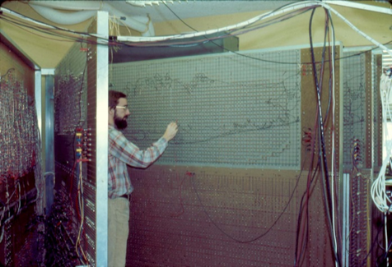
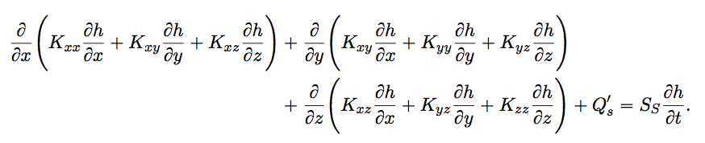
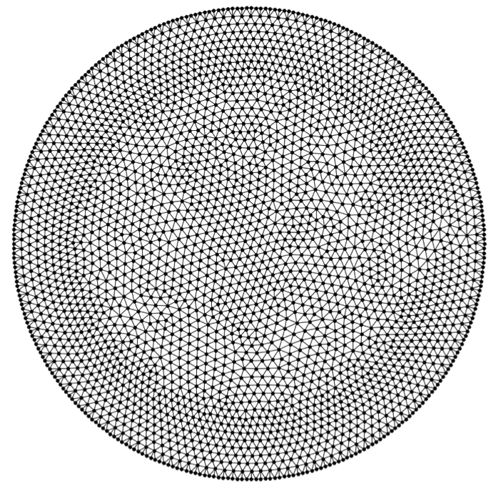
What is a model?
Physical models
Electric analog models
Mathematical models
Analytical models
Numerical models

Slide 3
Recommended Reading

Slide 4
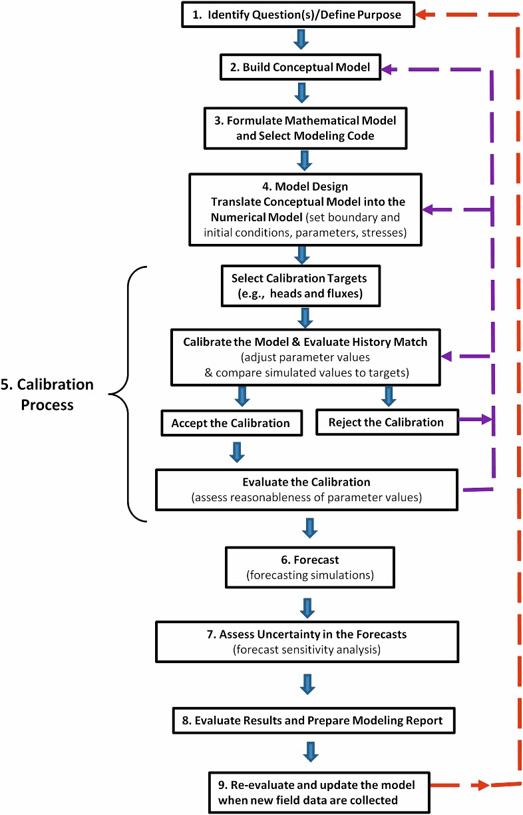
Workflow

Slide 5
Guidelines
Start simple
Build complexity as needed

Slide 6
1. Define Purpose

Slide 7
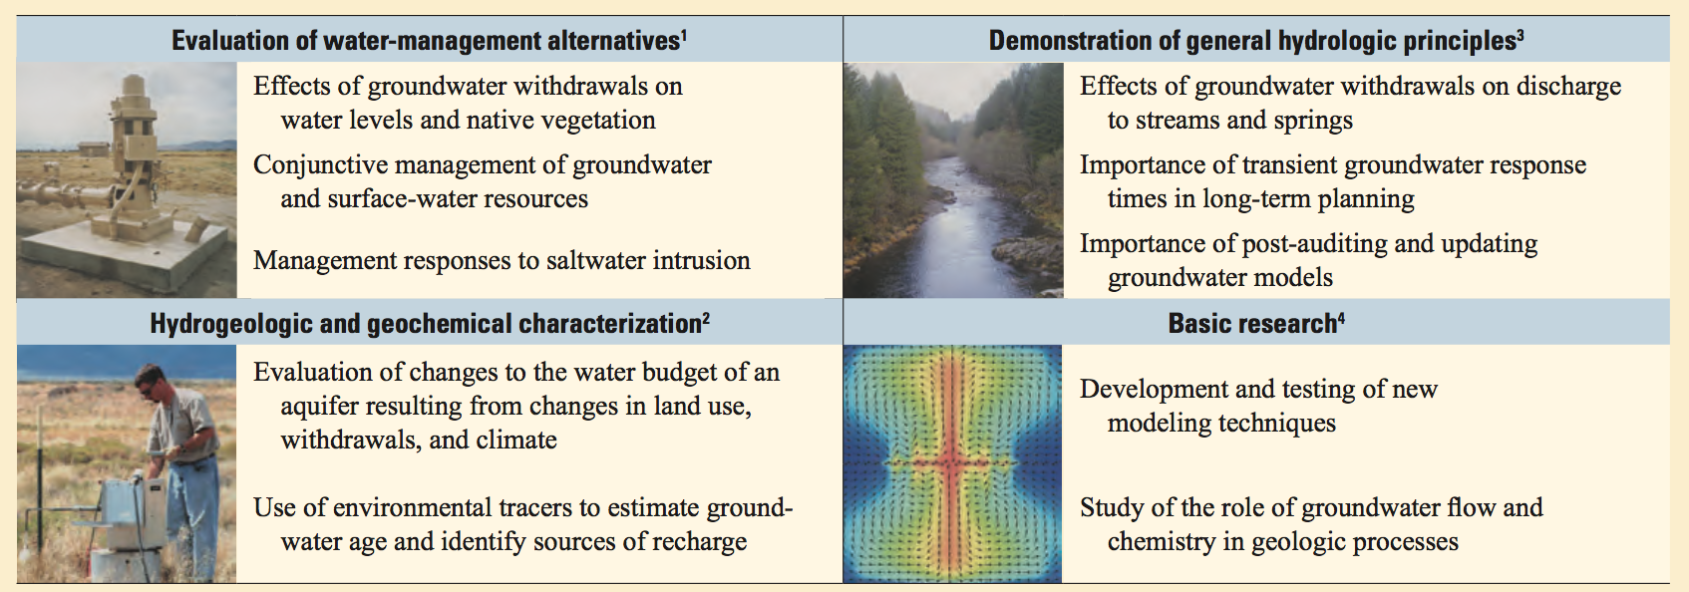
Why do we model?
Define the purpose

Slide 8
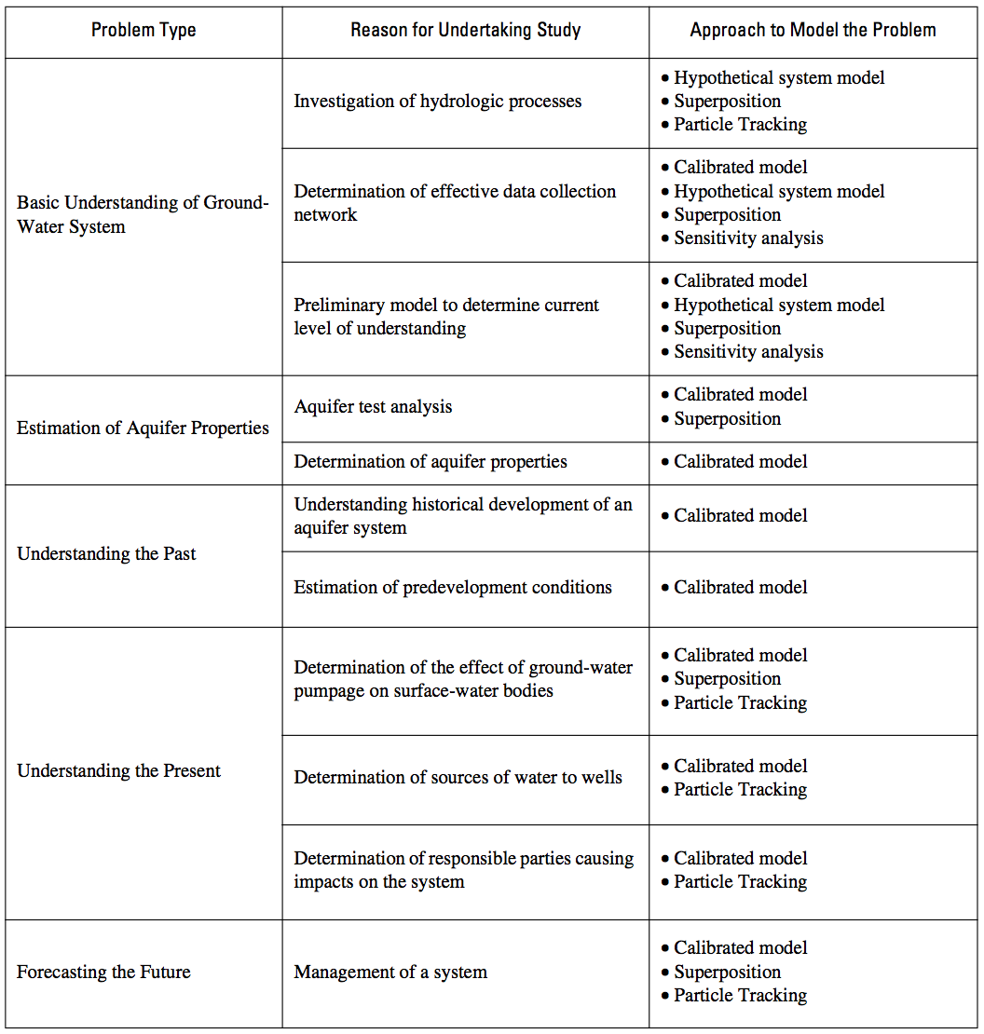

Slide 9
2. Conceptual Model

Slide 10
Conceptual Model
A synthesis of what is known about the area
“A conceptual groundwater flow model is a simplification of a real-world problem such that (1) it captures the essential features of the real-world problem and (2) it can be described mathematically.” -Haitjema, 1995

Slide 11
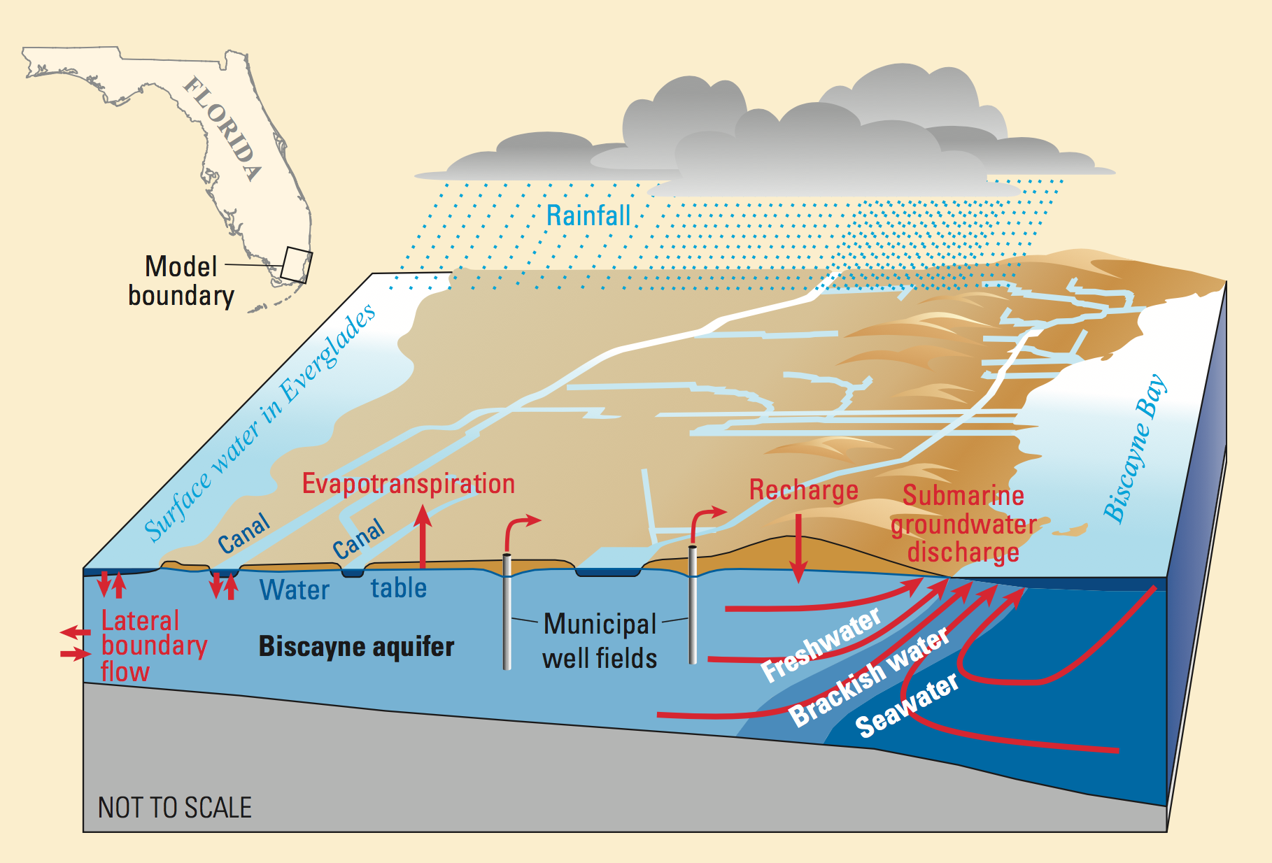
Biscayne Aquifer

Slide 12
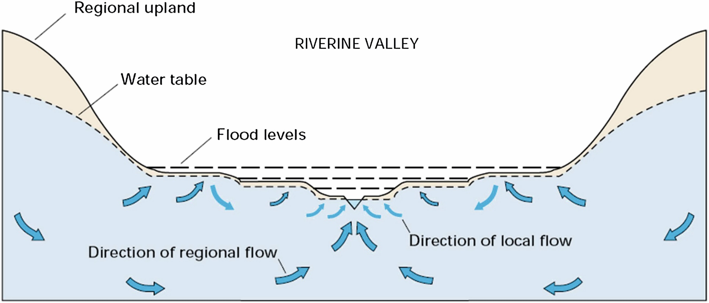
Figure 2.1 Generic conceptual model of a large riverine valley with terraces (Winter et al., 1998).

Slide 13
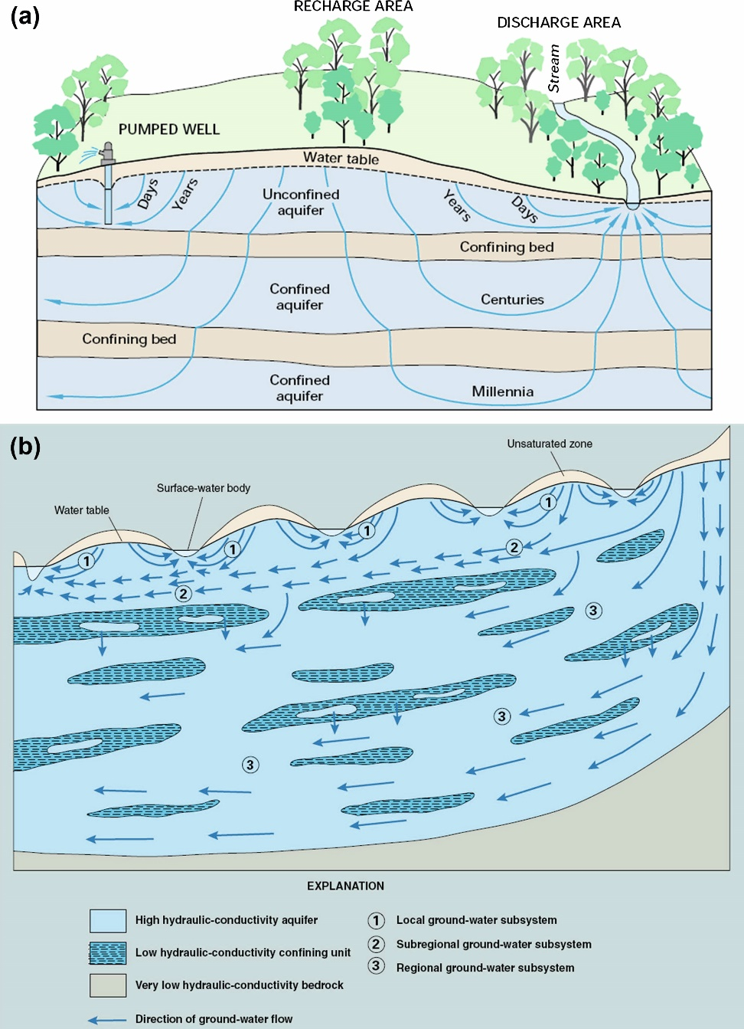
Figure 2.6 Generic conceptual models of aquitards showing: (a) timescales for flow through aquitards
(Winter et al., 1998); (b) discontinuous beds (Alley et al., 1999).

Slide 14
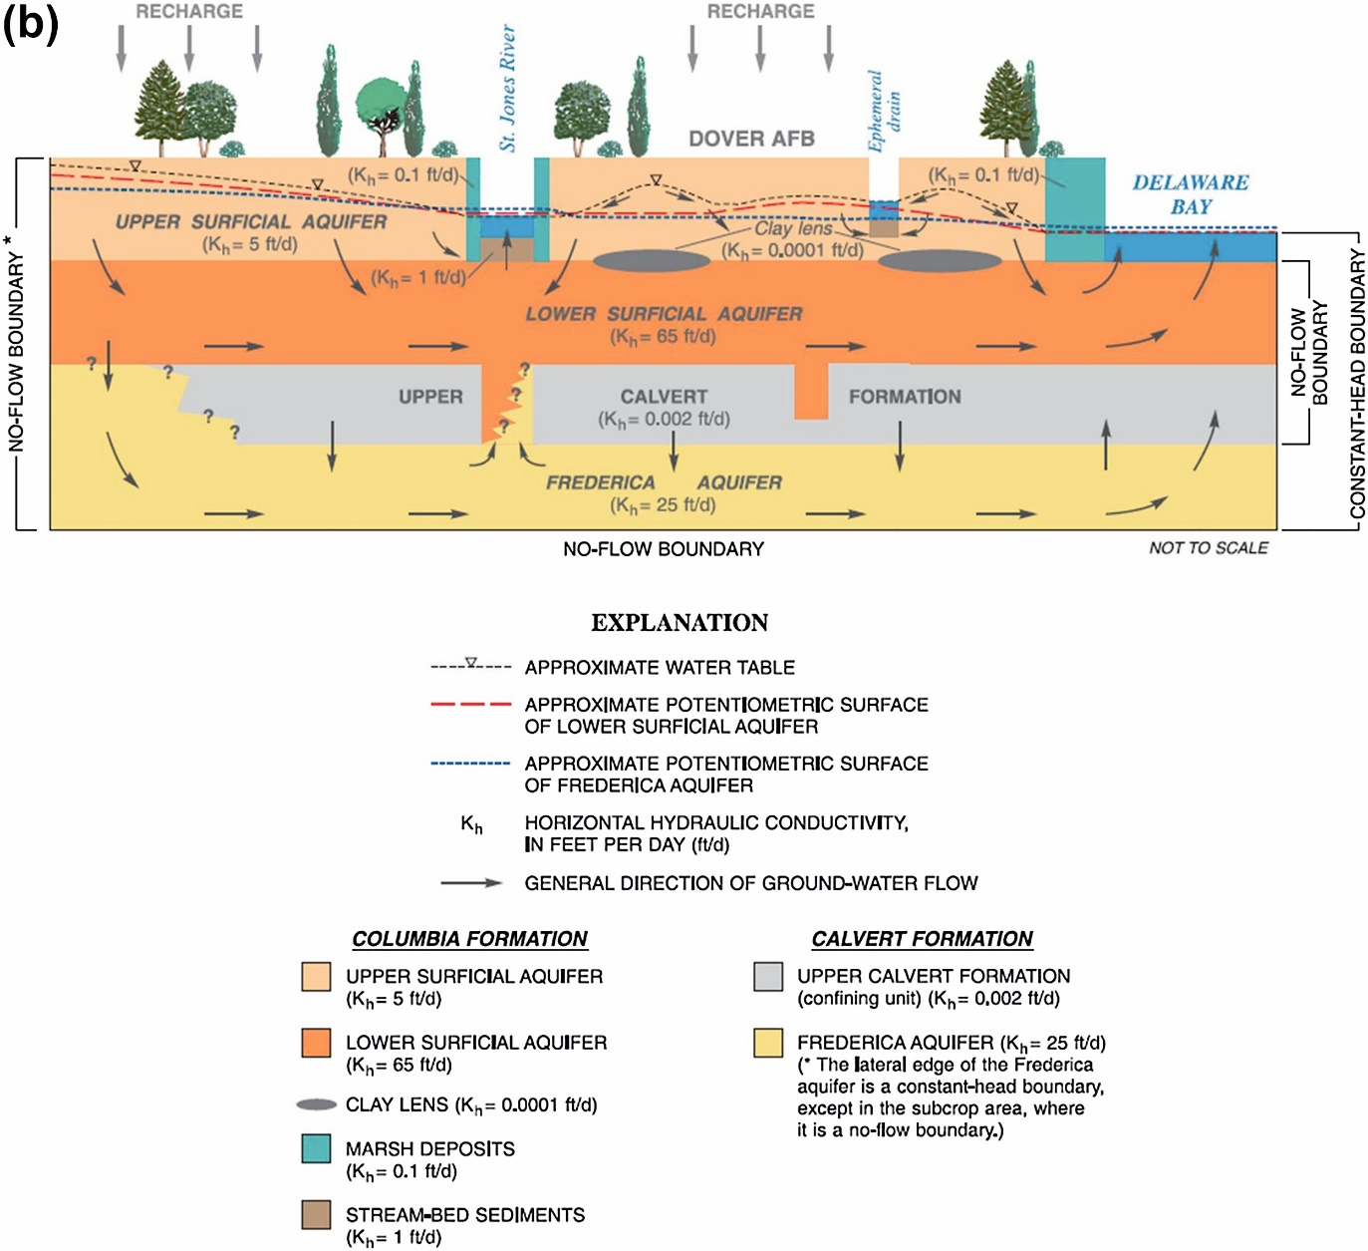
Figure 2.9 Cont'd. (b) Hydrostratigraphic units for the upper groundwater flow system at the Dover
Air Force Base, Delaware, USA, with estimates of hydraulic conductivity. Note that the confining bed
(upper Calvert Formation) is discontinuous (Hinaman and Tenbus, 2000).

Slide 15
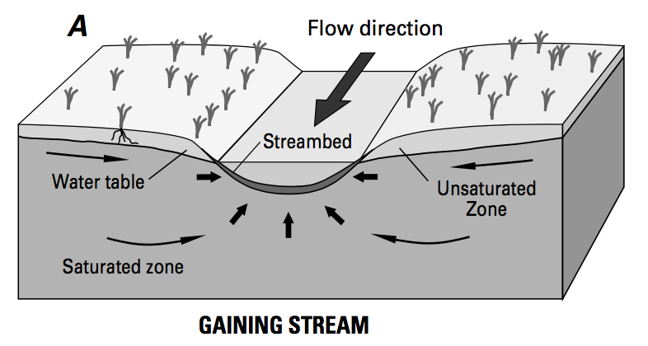
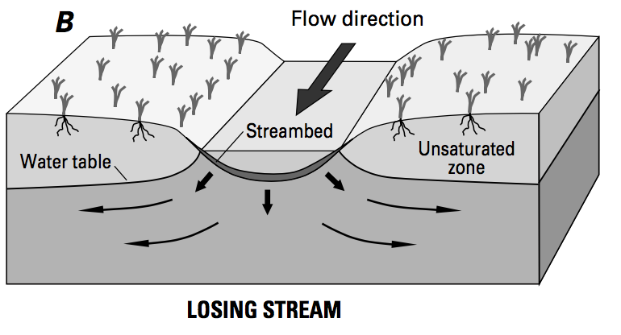
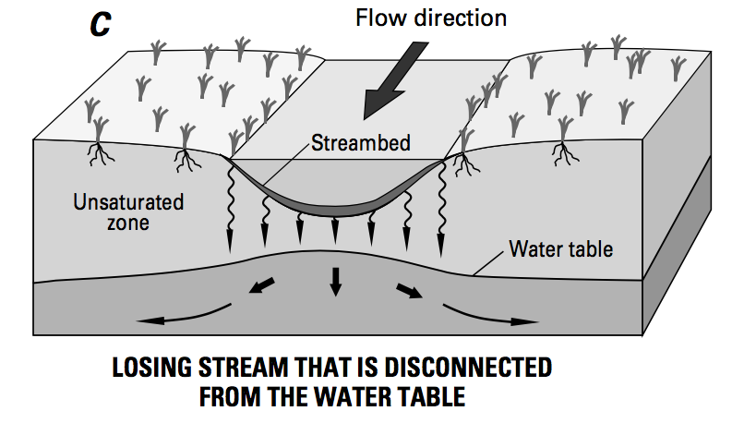
Conceptual Model

Slide 16
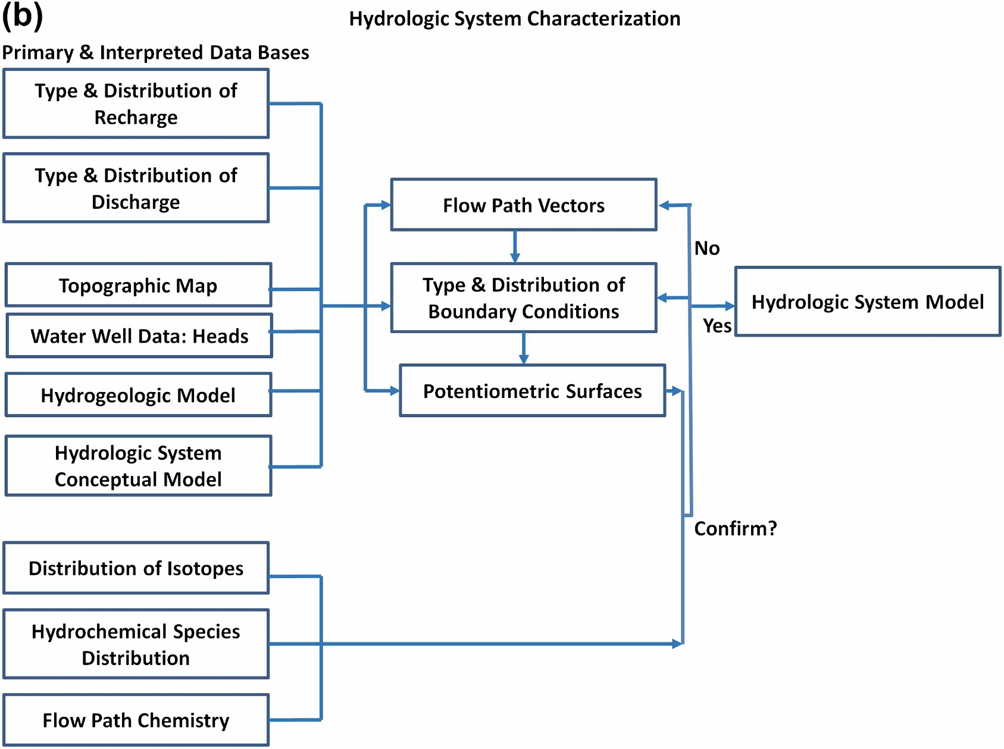

Slide 17
3. Mathematical Model

Slide 18
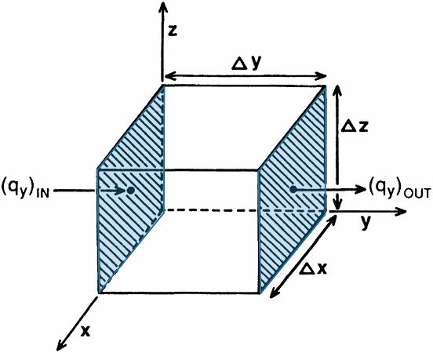
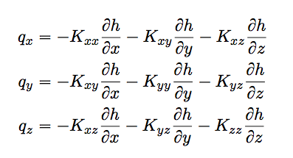
Mathematical Model

Slide 19
Solving the Mathematical Model
Partial differential equations
Initial conditions
Boundary conditions

Slide 20
Solving the Mathematical Model
Analytical solution: h = f(x, y, z, t)
(example: Theis equation)
Numerical solution
Finite Volume
Finite Element
Analytic Element Methods

Slide 21
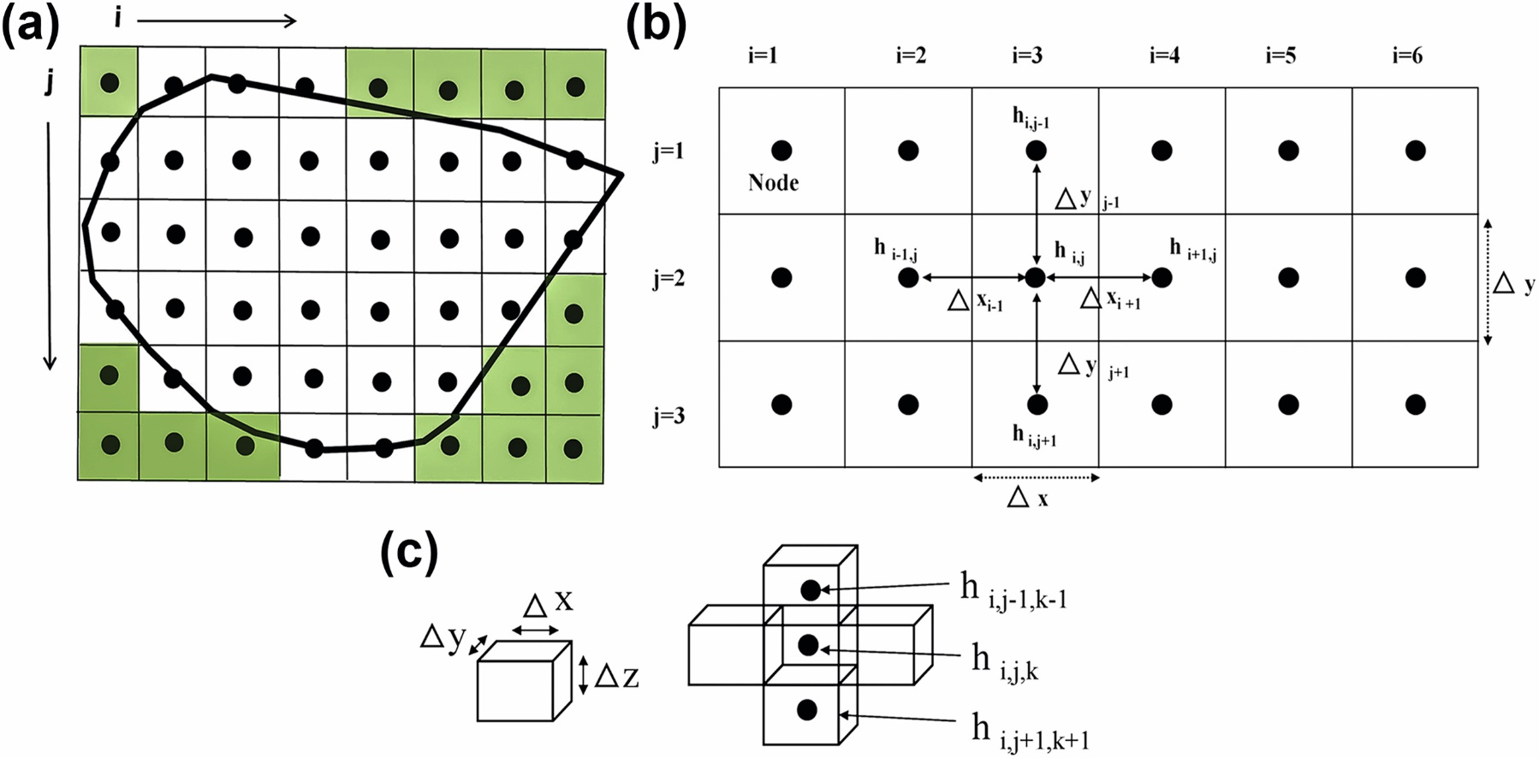
Figure 3.4 Finite-difference (FD) grid and notation. (a) Two-dimensional (2D) horizontal FD grid with uniform nodal spacing; i = columns and j = rows. Sometimes a different indexing convention is used. For example, in MODFLOW i = rows and j = columns. The cells are block-centered; the heavy dark line represents the problem domain. Inactive cells (those outside the boundary of the problem domain) are shaded. (b) 2D horizontal FD grid with notation for the group of five nodes comprising the FD computational module (star) centered around node (i,j). (c) Three-dimensional notation where Δz represents the vertical distance between nodes and k is the vertical index. The group of blocks at the right is shown in 2D space (the two blocks perpendicular to the page along the y-axis are not shown). The group of seven nodes including node (i,j,k) comprise the FD computational module in three dimensions.

Slide 23
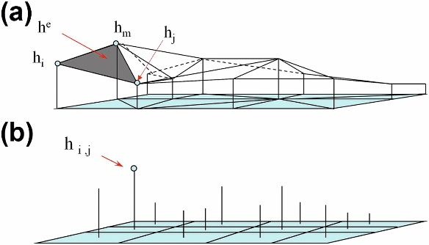
Figure 3.7 Representation of head in the finite-element (FE) and finite-difference (FD) methods. (a) In the FE method, head (h^{e}) is a continuous function within each element. In the FE mesh shown in the figure, the elements are triangular with heads at nodes designated h_{i}, h_{j}, and h_{m}. (b) In the FD method, head (h_{i,j}) is defined only at the node.

Slide 24
Code Selection
What does the code need to do?
Has the code been verified?
Track record?
Does the code have a GUI?
Popular codes
MODFLOW
FEFLOW
SUTRA

Slide 25
4. Model Design

Slide 26
Dimensionality
1, 2, or 3 dimensions
2-Dimensional models
Areal
Cross sectional
3-Dimensional models

Slide 27
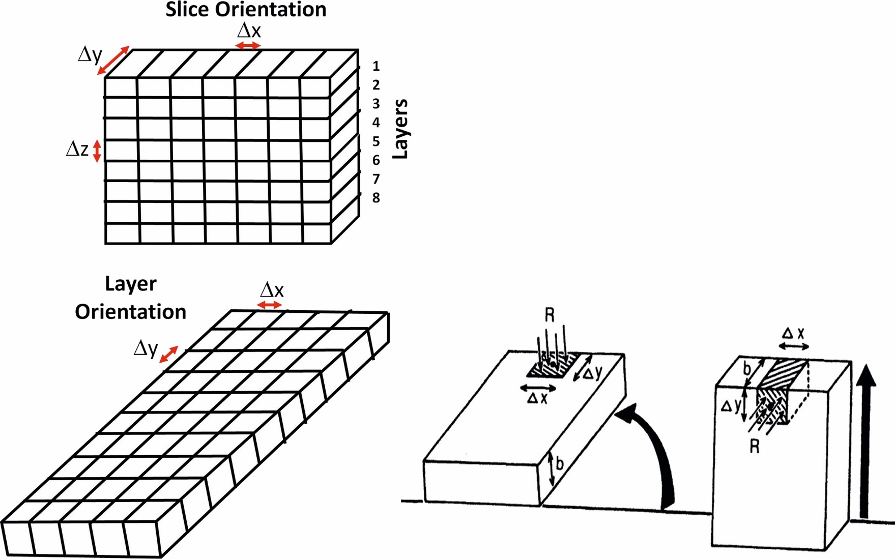
Figure B4.2.2 In layer orientation (bottom three figures) the profile is simulated as an areal two-dimensional model. The thickness of the layer equals the width of the profile. Slice orientation (top figure) is shown for comparison.

Slide 28
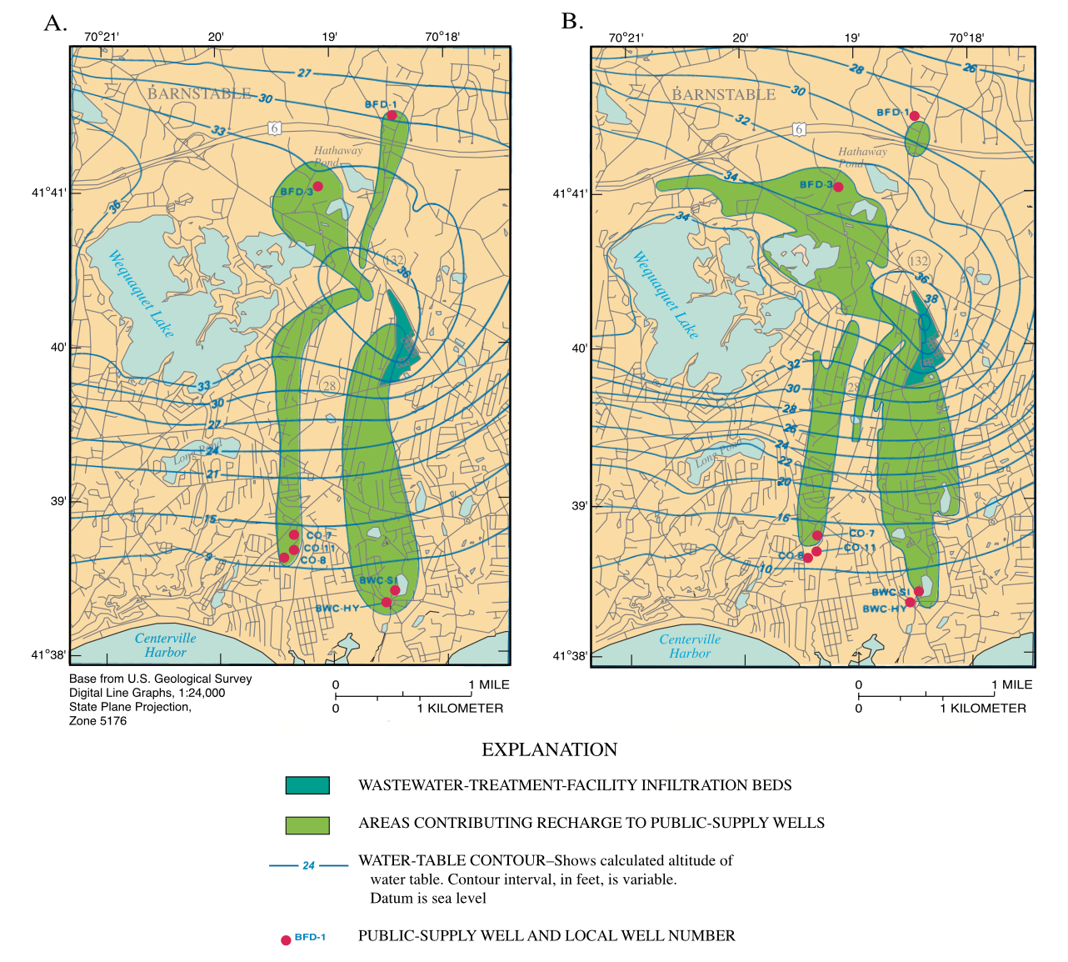
2D or 3D?

Slide 29
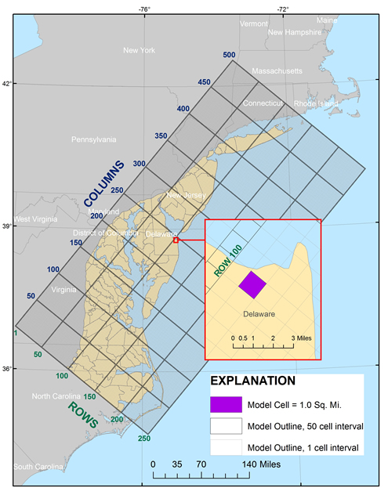
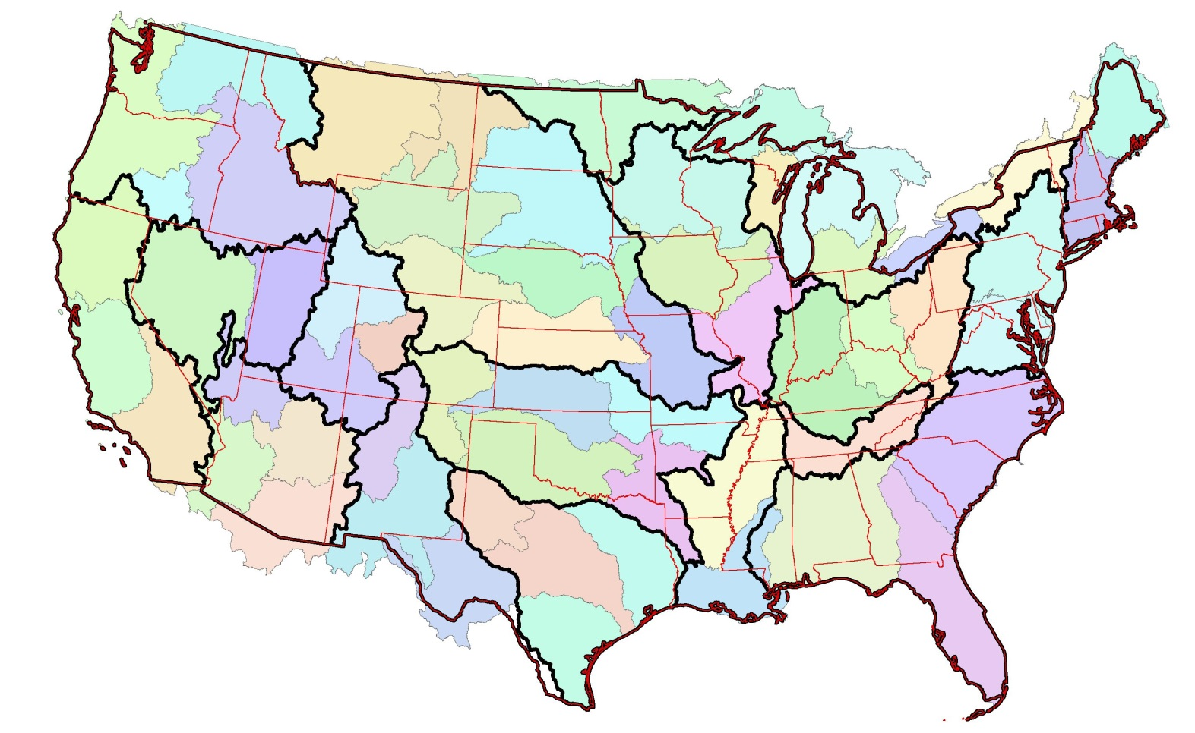
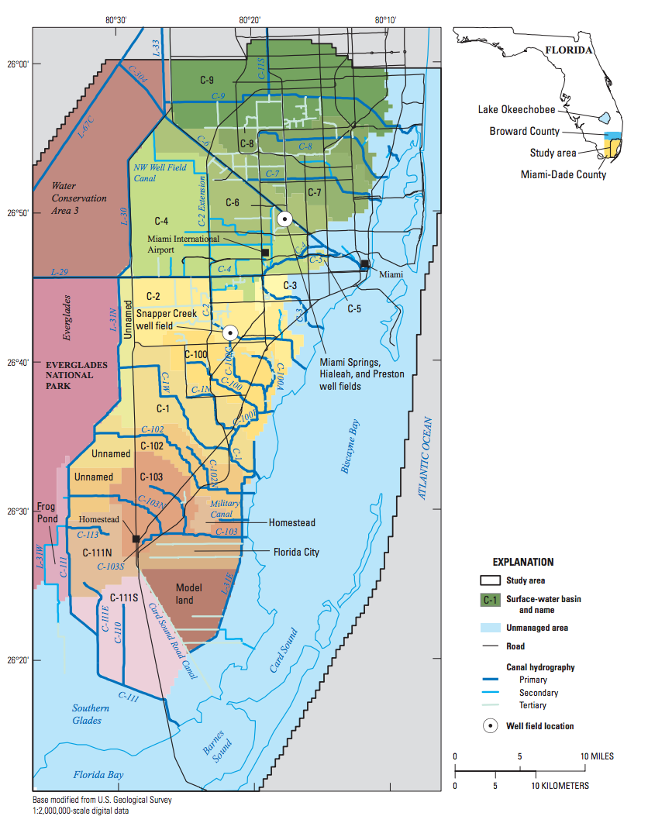
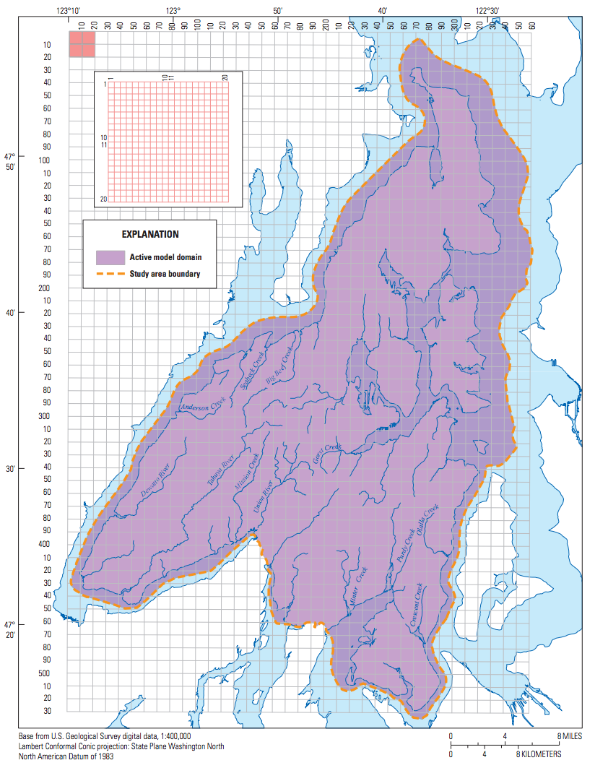
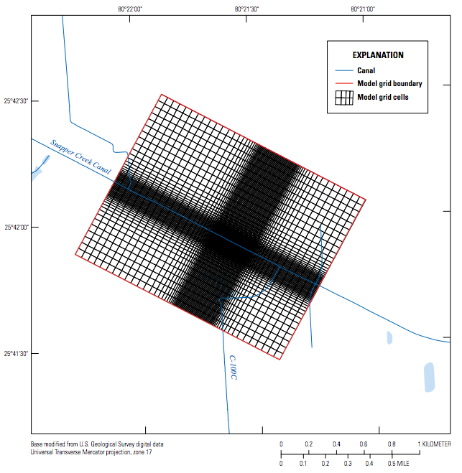
Scale
regional/state
continental
county/subregional
municipal
site
Notes:
NRP Continental groundwater model – 65 models, single layer, 300 m resolution,
Unique at USGS compared to consultants and other govt agencies in that we work over many different scales.

Slide 30
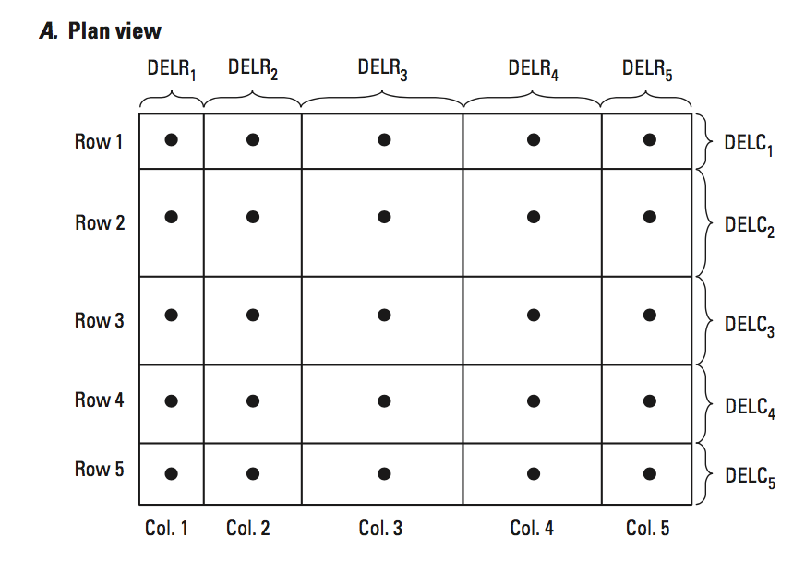
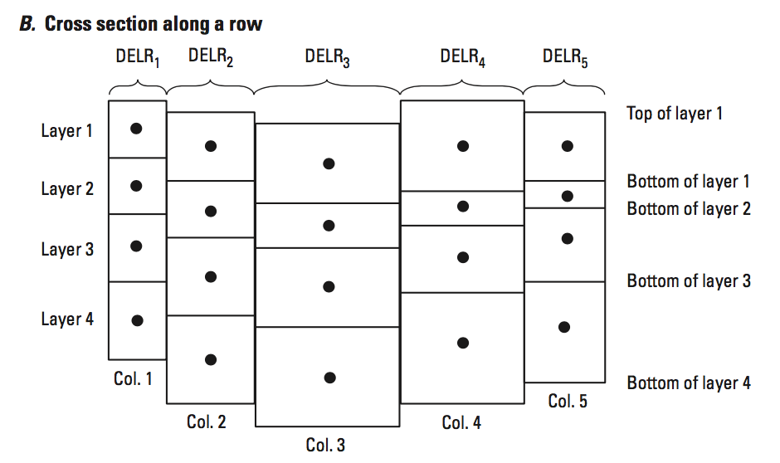
Discretization

Slide 31
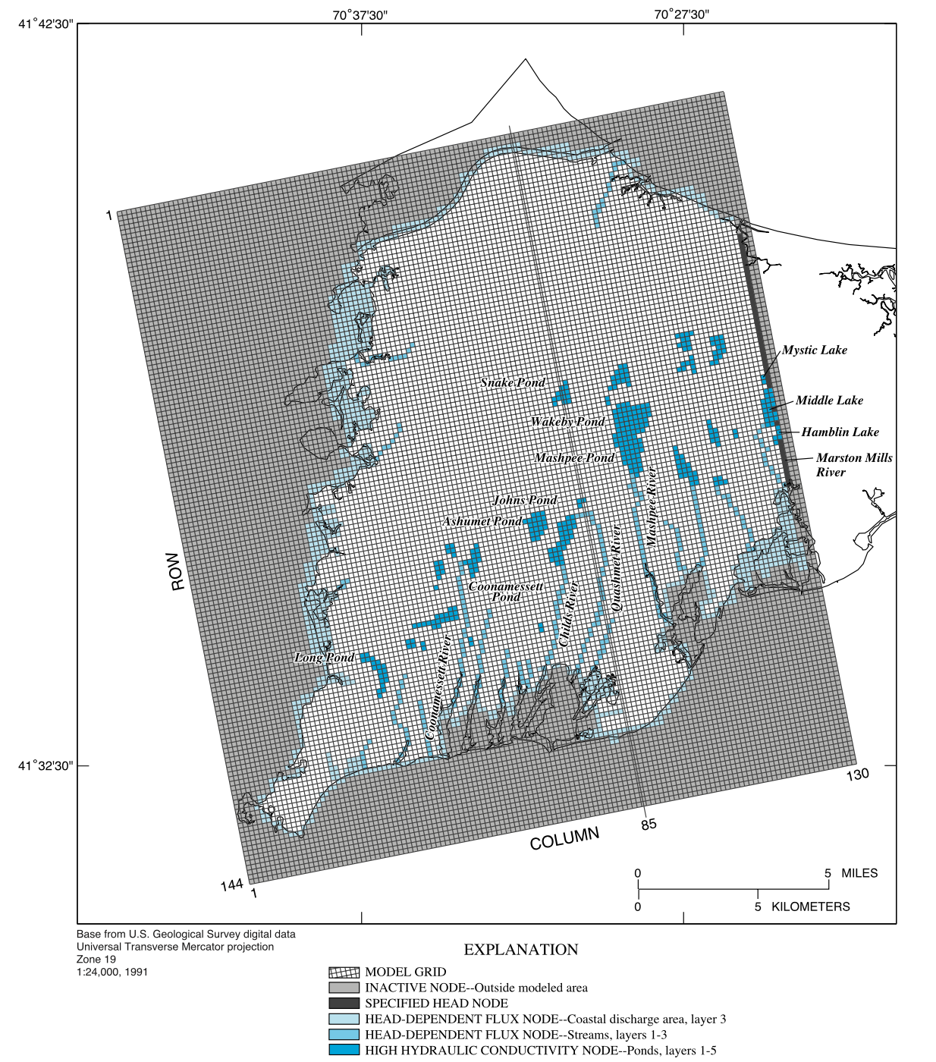
Model Grid

Slide 32
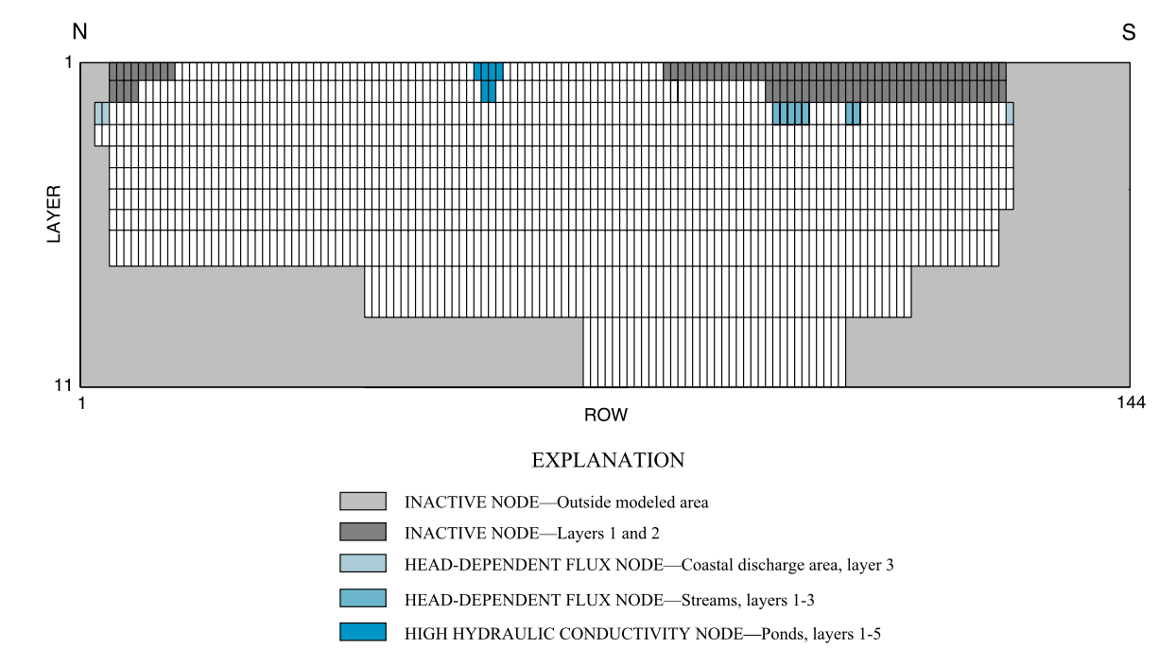
Cross Section

Slide 33
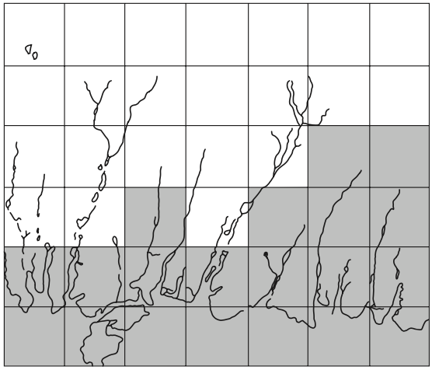
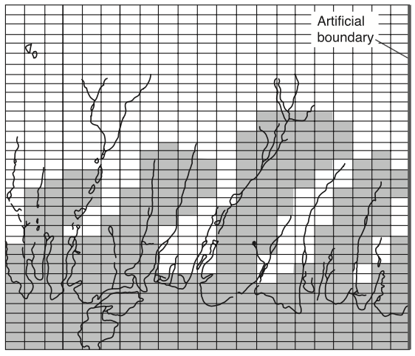
Resolution

Slide 34
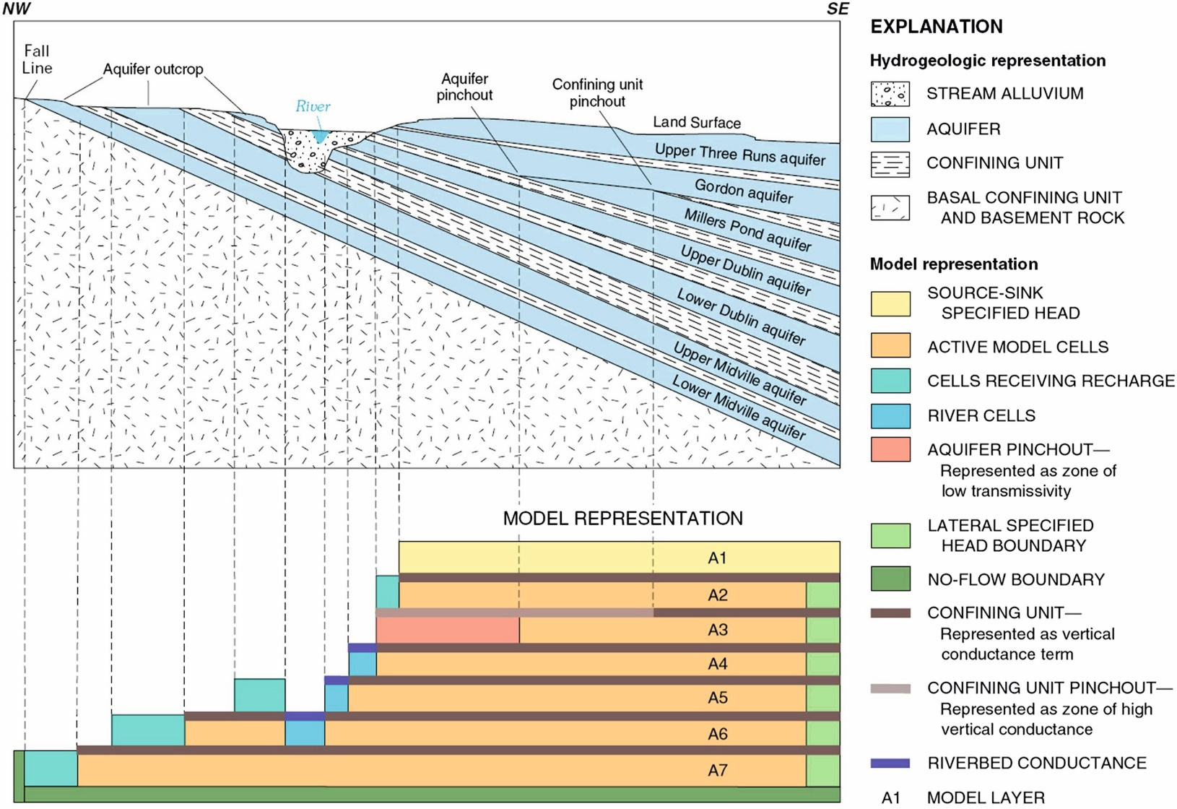
Layering
Figure 4.6 Schematic diagram showing the hydrogeology and model layers for a seven layer quasi-
3D model of the Savannah River Site, SC, USA. Confining beds are not represented in the FD grid but are indirectly included in the model by representing the vertical resistance of the confining beds by leakance and flow through the layers by leakage terms (Clark and West, 1998).

Slide 35
Boundary Conditions
Specified Head
Type 1
Dirichlet
Specified Flow
Type 2
Neumann
Head-Dependent Boundary
Type 3
Cauchy

Slide 36
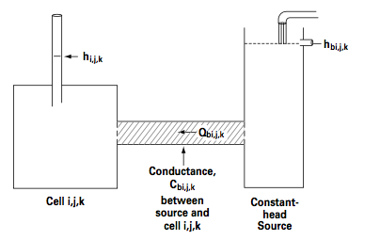
MODFLOW Boundary Conditions
Traditional
Well
Drain
River
General-Head Boundary
Recharge
Evapotranspiration
Advanced
Stream-Flow Routing
Unsaturated Zone Flow
Multi-Node Well
Lake

Slide 37
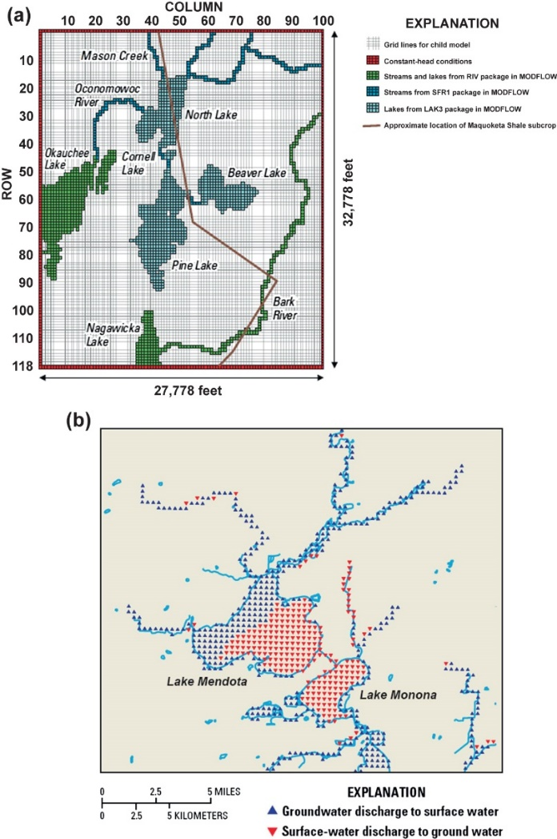

Slide 38
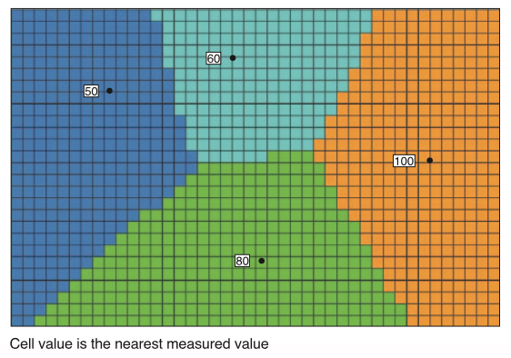
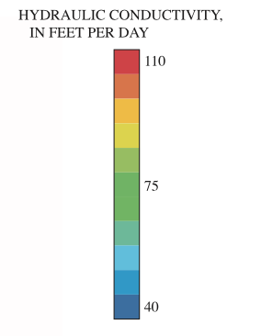
Parameter Assignment

Slide 39
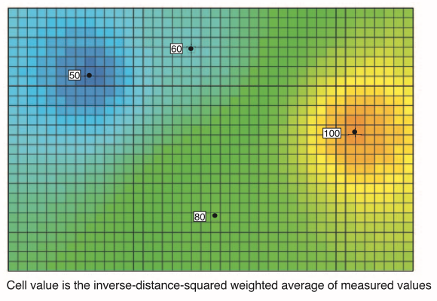
Parameter Assignment

Slide 40
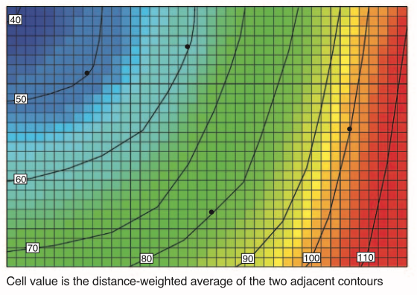
Parameter Assignment

Slide 41
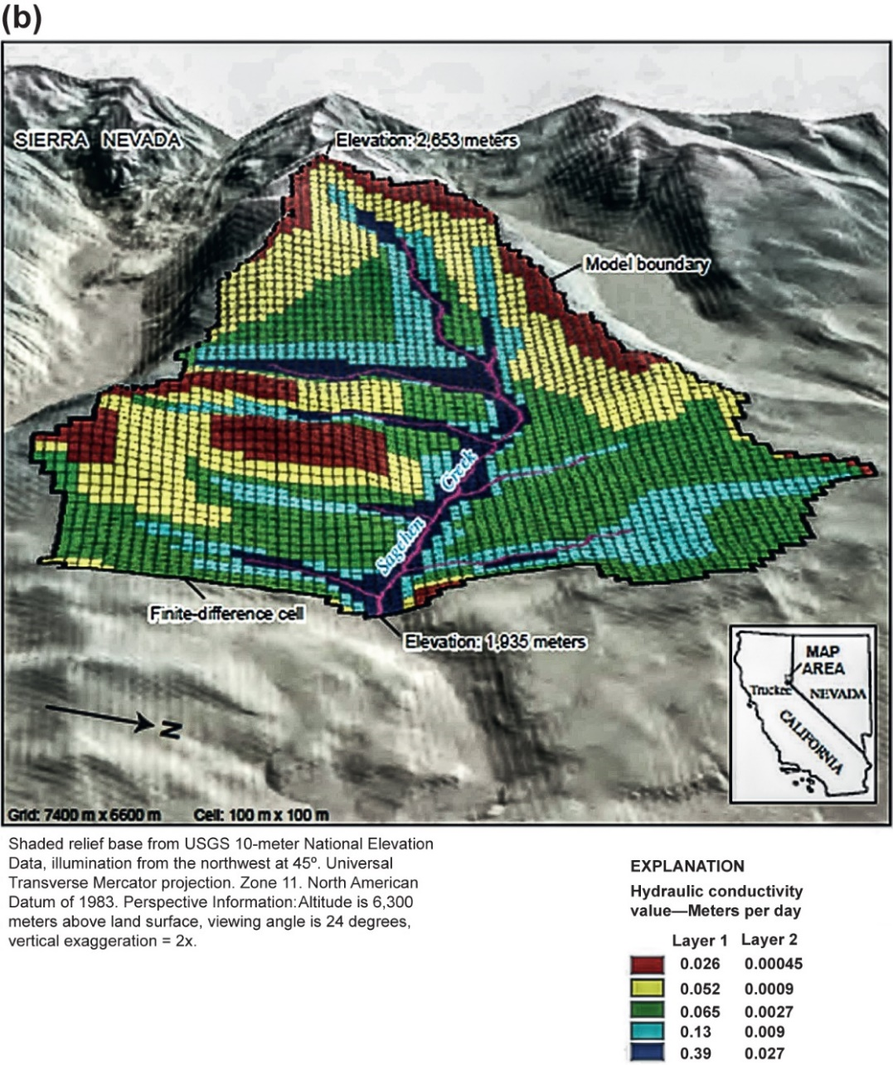
Figure B6.2.3 Cont'd. (b) FD grid and values of hydraulic conductivity used in MODFLOW (Markstrom et al., 2008).

Slide 42
Temporal Considerations
Steady State
In – Out = 0
Heads do not change with time
Transient
In – Out = Change in Storage
Time is divided into time steps

Slide 43
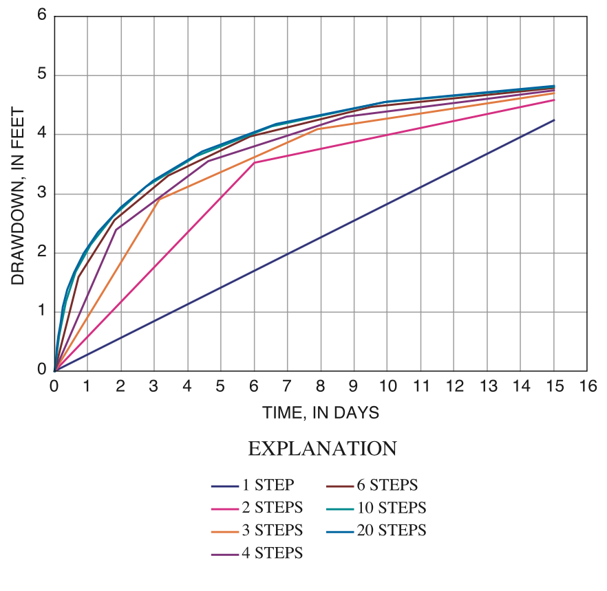
Temporal Discretization

Slide 44
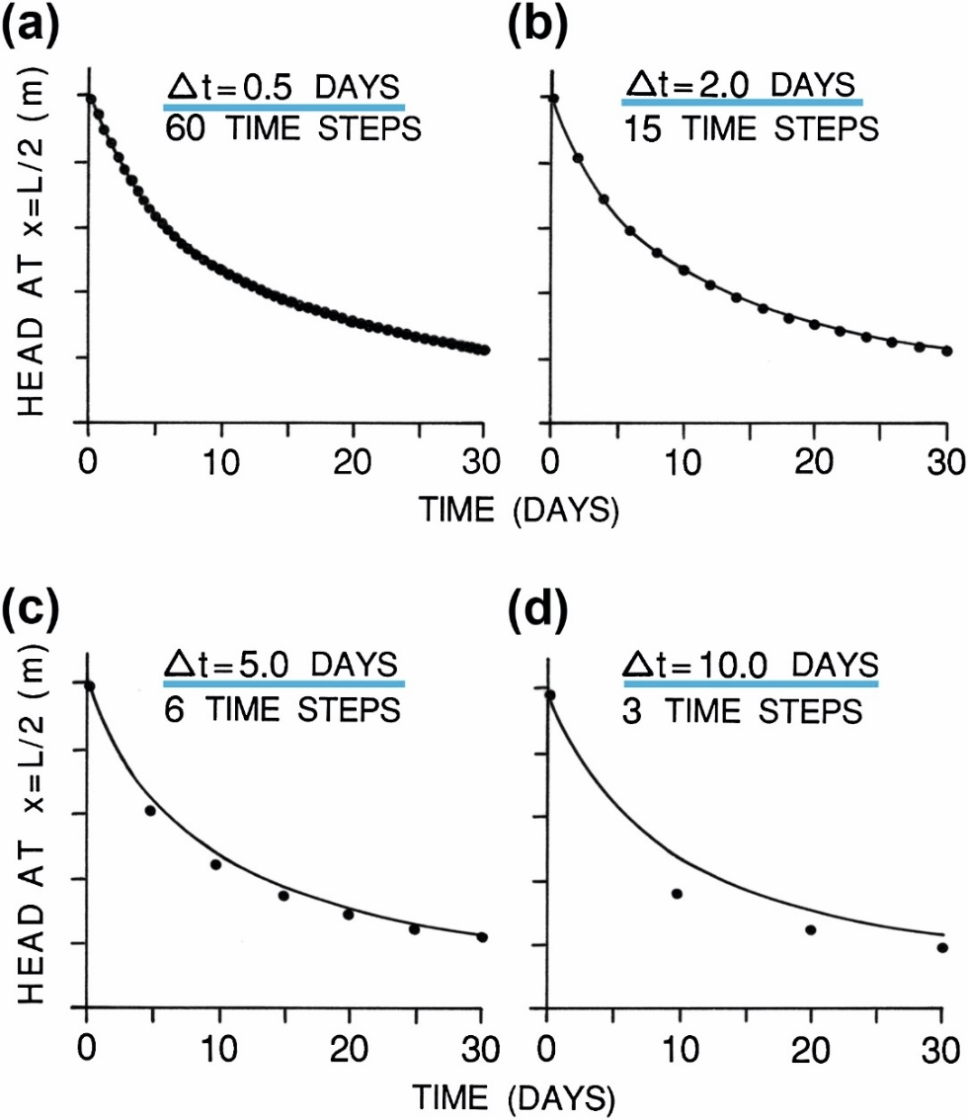
Figure 7.9 Effect of the size of the time step (Δt) on the numerical solution (dots) for the decay of a groundwater mound compared to an analytical solution (solid line). Small time steps in (a) and (b) give results that match the analytical solution very well. The larger time step in (c) also provides an acceptable match to the analytical solution. The time step in (d) produced results that do not match the solution within the first 30 days (modified from Townley and Wilson, 1980).

Slide 45
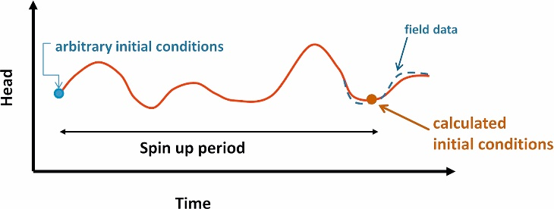
Figure 7.7 Schematic hydrograph showing transient model spin up to generate initial conditions. Arbitrary initial conditions at the beginning of the spin up might be based on historical information about predevelopment water levels (blue dot). Simulated results are shown by the red line. Results for the spin-up period are not used but heads at the end of the spin up are matched to field observations (dashed blue line). The calculated heads at the end of the spin-up period (shown by the brown dot) effectively provide initial conditions for the rest of the transient simulation.

Slide 46
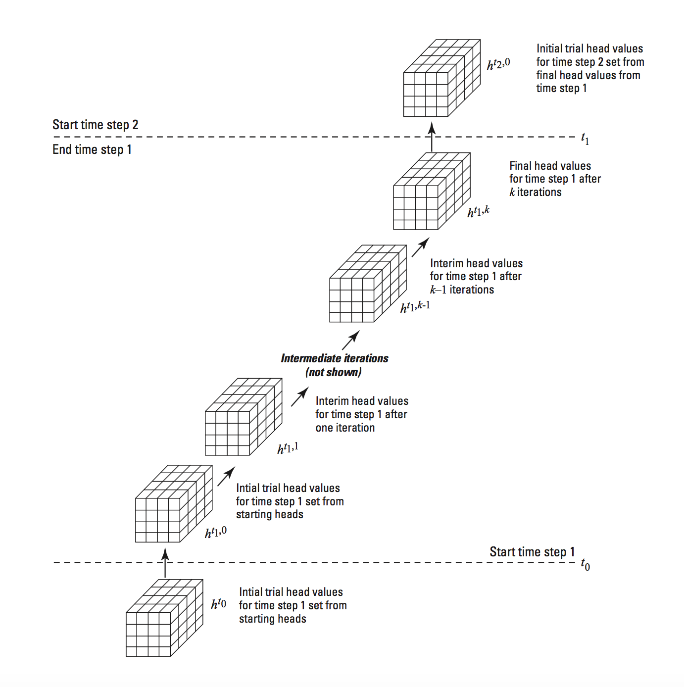
Transient Solution

Slide 47
5. Calibration

Slide 48
Calibration
Groundwater systems are never known perfectly
Inverse problem
Adjusting model input until model output matches observations (history matching)
Approaches
Manual Trial and Error
Automated Approaches
Gradient-based methods
Global methods

Slide 49
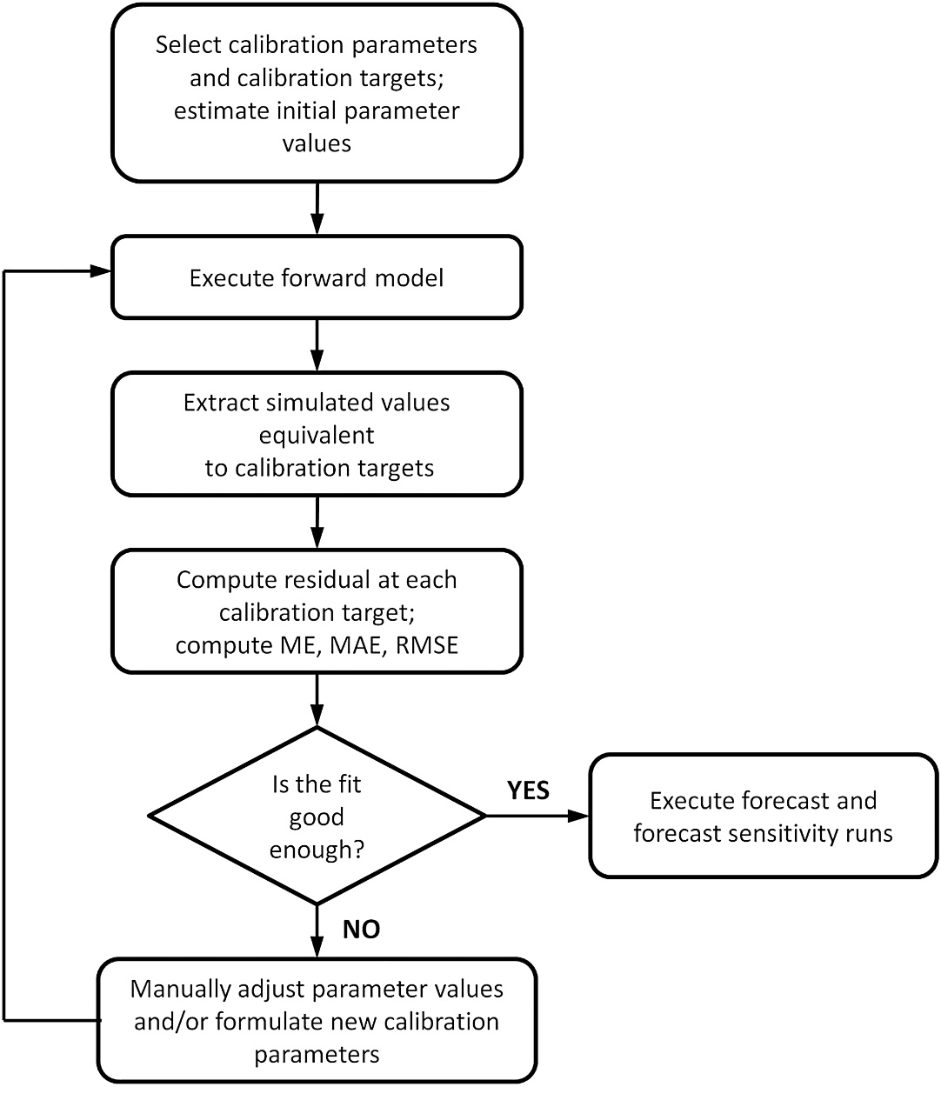
Figure 9.1 General workflow for manual trial and error, the first phase of history matching a model intended for forecasting (ME, mean error; MAE, mean absolute error; RMSE, root mean squared error).

Slide 50
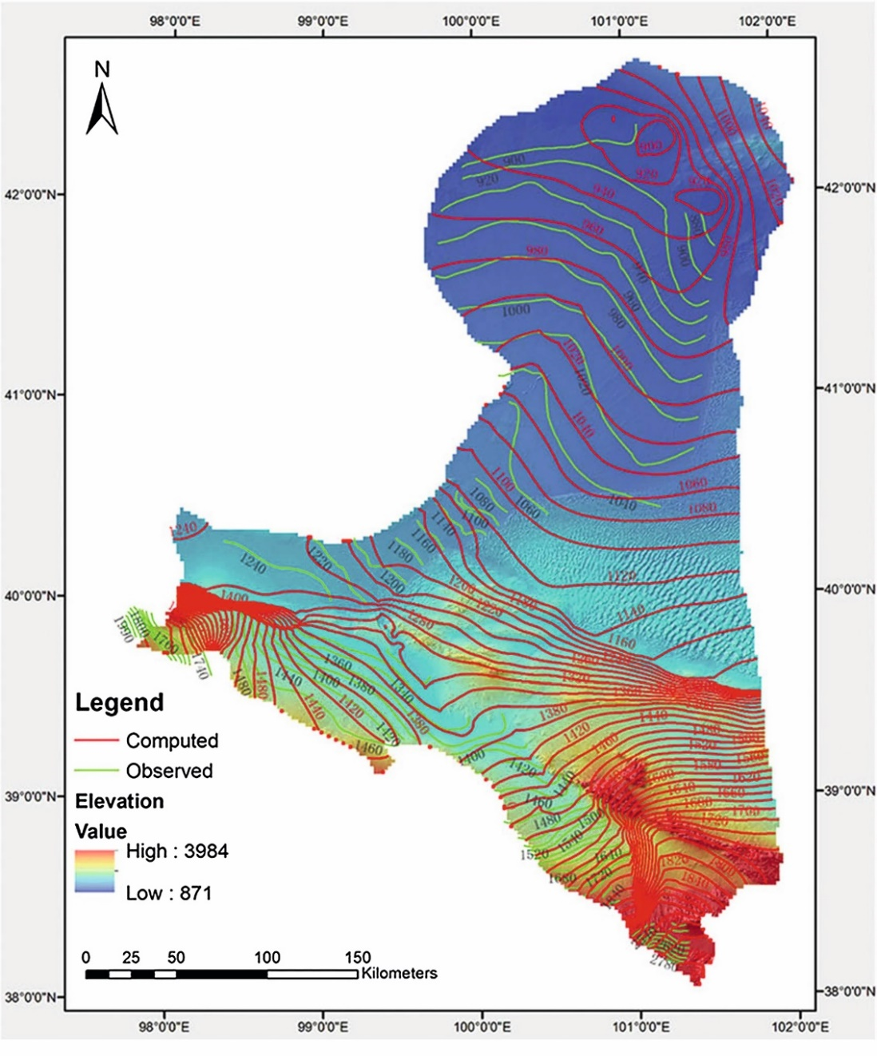
Figure 9.3 Map view of observed (green) and simulated (red) water table (shown by contours) in an arid inland river basin in China. Topographic elevations are shown by color shading (Yao et al., 2014).

Slide 51
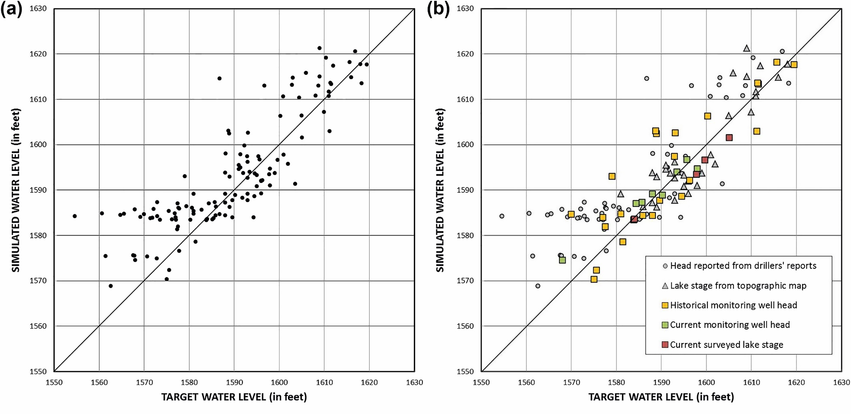
Figure 9.5 Scatter plot (a) and categorized scatter plot (b) of simulated to observed fit of water levels. The categories in (b) can convey the modeler’s assessment of target quality, here ranging between observations roughly estimated (small, gray dots) and more accurate observations (larger, colored symbols). The 1:1 perfect fit line is also shown for reference to visualize bias (modified from Juckem et al., 2014).

Slide 52
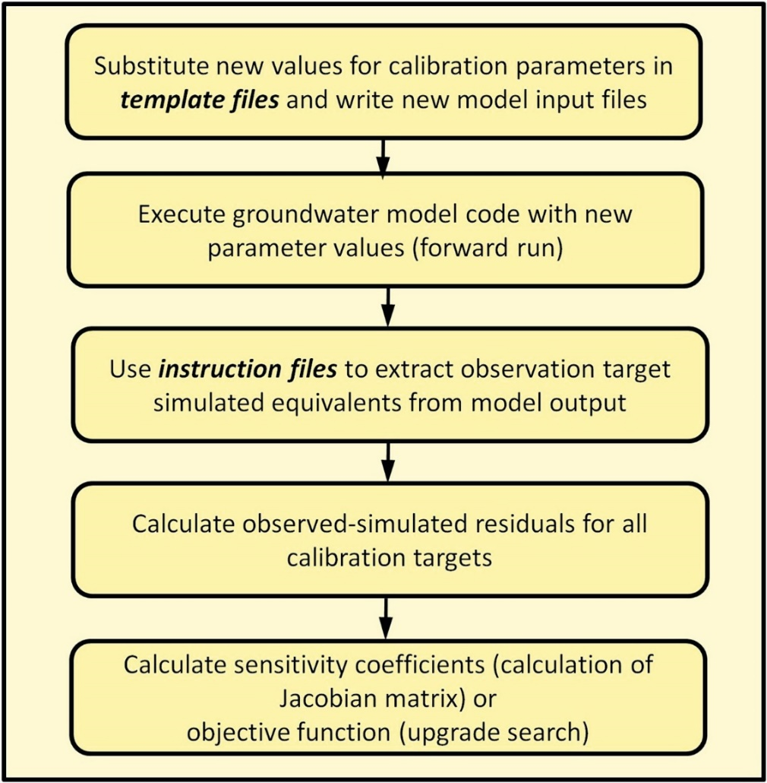
Figure 9.8 A schematic workflow diagram of the mechanics of each forward run automated by a universal nonlinear regression parameter estimation code. The shaded background in the figure indicates that the steps are performed internally by the code without user intervention. Two types of ASCII (American Standard Code for Information Interchange) files are required before the parameter estimation code can be run: (1) a template file that specifies where to place new values of calibration parameters in the model input file; and (2) an instruction file that extracts relevant model outputs for comparison to observed calibration targets. Both required files are typically created by a graphical user interface (GUI).

Slide 53
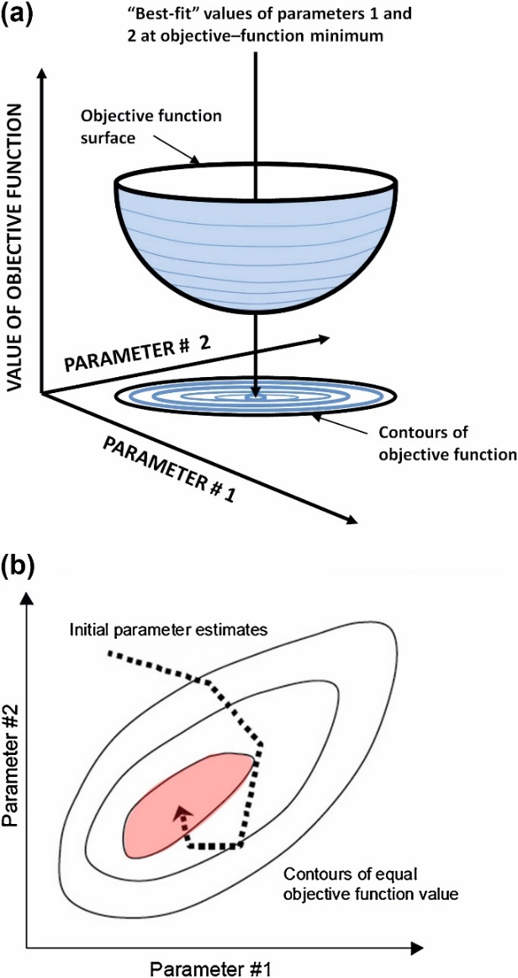
Figure 9.10 (a) Idealized objective function surface for a two-parameter problem (modified from Himmelblau, D.M., 1972, Applied Nonlinear Programming, McGraw-Hill, New York, reproduced with permission of McGraw-Hill Education). (b) improvement in the solution via parameter upgrade in successive parameter estimation iterations (shown by the dashed line) leading to the objective function minimum (from Doherty, 2014a).

Slide 54
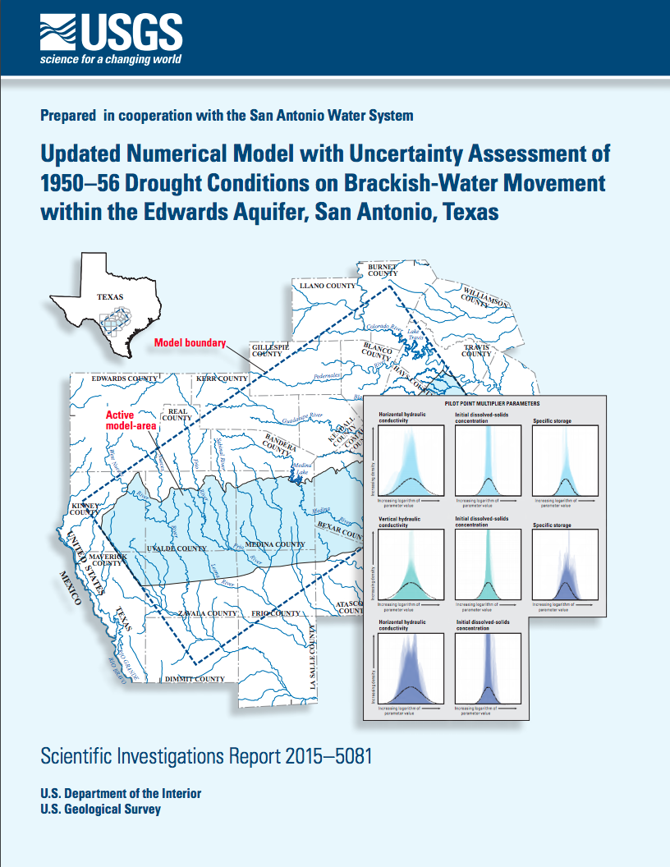
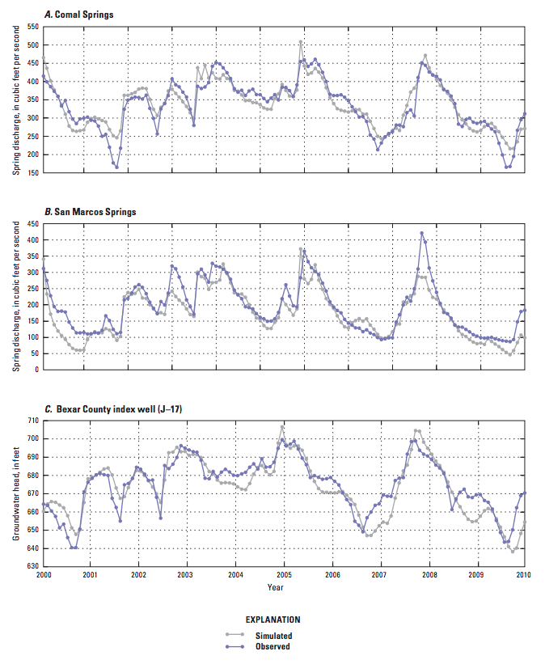

Slide 55
6. Forecasting, and 7. Uncertainty Analysis

Slide 56
Forecasting
Use of the model to address purpose of the study, such as to predict future response
Beware of forecasts that are not informed by the calibration
Models do better at forecasting conditions that are similar to the calibration period

Slide 57


Forecast First?

Slide 58

Courtesy: Jeremy White

Slide 59

Courtesy: Jeremy White

Slide 60
8. Document

Slide 61
Wrapping it all up…
Modeling report
Archiving the model
Reviewing the report and model

Slide 62

Modeling Report
Things to think about:

Slide 63


Slide 64

Model Archives

